Slide 1

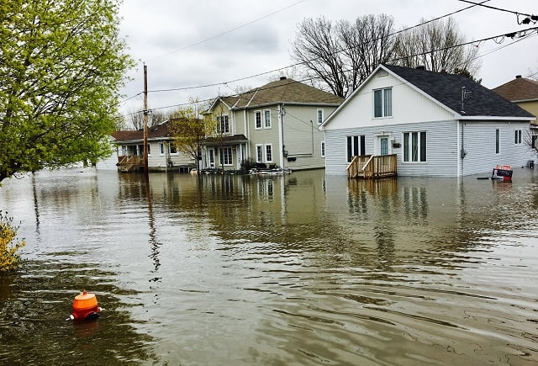
Satelliete Project Flood Radar
Cairo University
Faculty of Engineering
Prepared by Team VII
Supervised by Eng. Amr AbdElBaky

Slide 2
Agenda
0
1
2
Motivation
Data Preparation
Feature Extraction
3
4
Models
PerPixel Segmentation
5
6
Application
Results & Evaluation

Slide 3
Motivation
Utilizes machine learning and computer vision techniques to accurately
determine whether satellite imagery is flooded or not.
Effectively segment all pixels corresponding to flooded regions in
the classified images.

Slide 4
Data Preparation
Reading the images
Normalizing the images
Changing the images to grayscale
Applying a list of albumentations transformations
Transposing the images to be either channel-first or channel-last
Saving the processed images

Slide 5
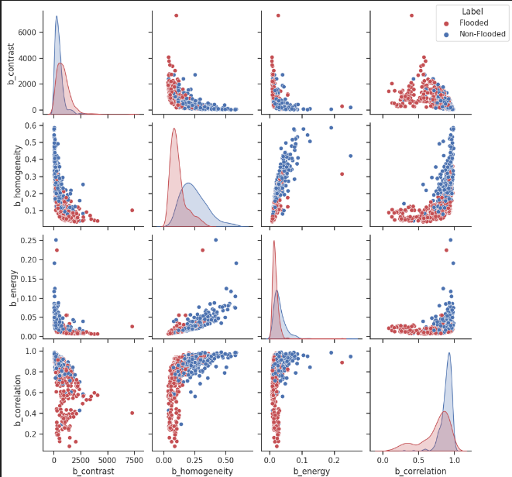
Feature Extraction
The Following Classical features were considered:
HIST
GLCM
Hog
LBP
GLCM Seperability

Slide 6
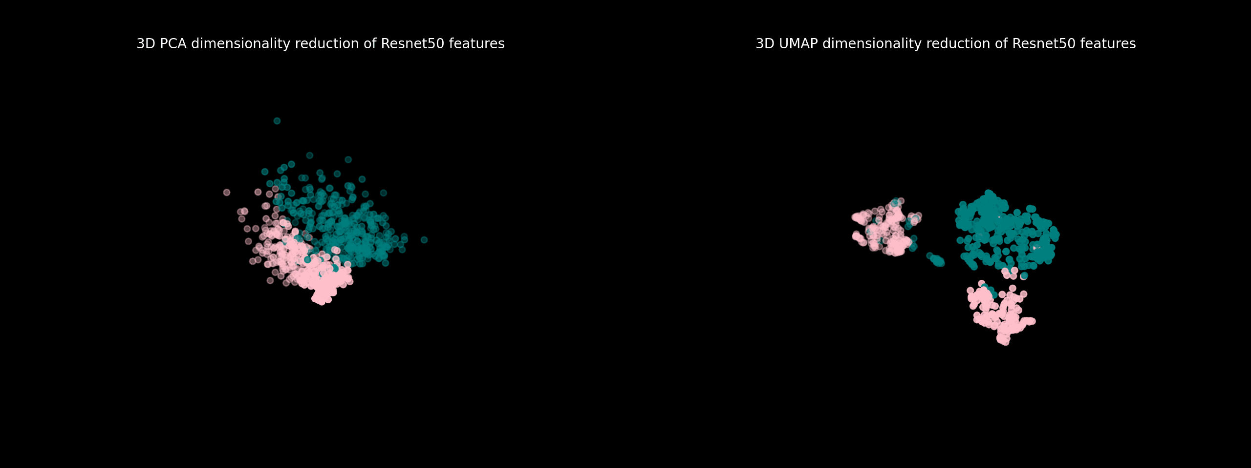
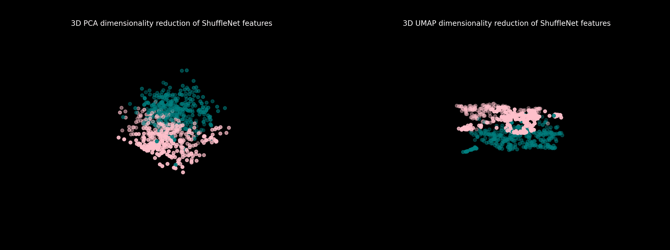
Feature Extraction
The Following Deep features were considered:
ResNet
ShuffleNet

Slide 7
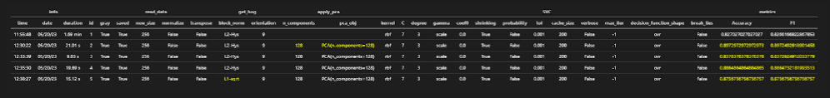
Models: SVM
I. Deep features
II. GLCM features
III. Hog Features
IV. LBP Features
V. ShuffleNet Features

Slide 8
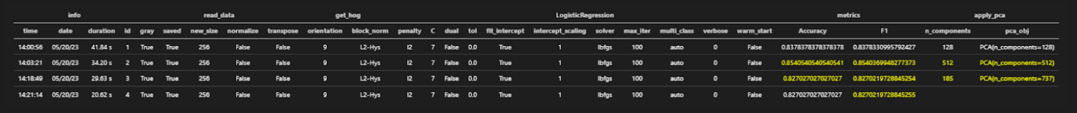
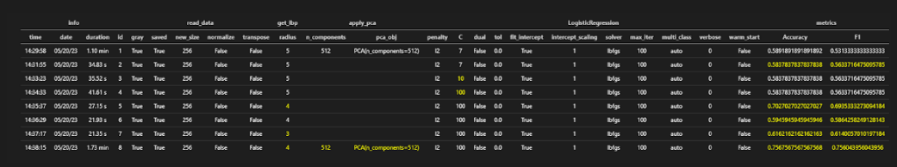
Models: Logistic regression
I. HOG features
II. GLCM features

Slide 9
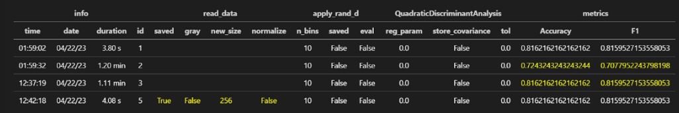
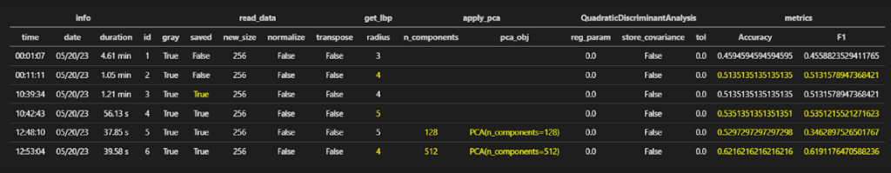
Models: QDA
I. HOG features
II. LBP features

Slide 10
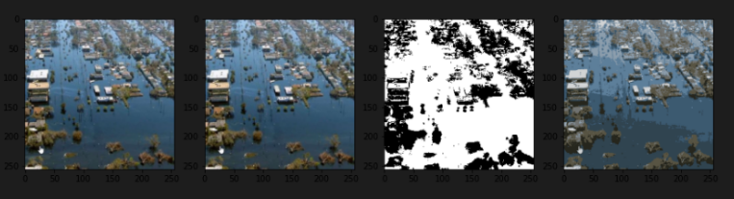
PerPixel: Kmeans
The clustering methods used:
Kmeans
Isodata
Segmentation Results

Slide 11
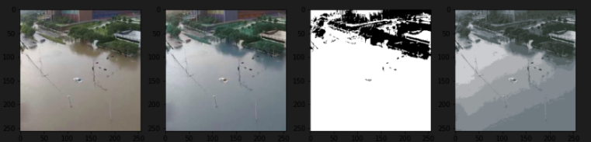
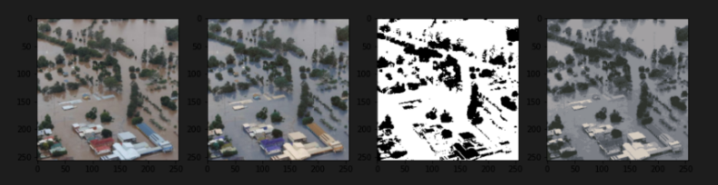
PerPixel: Kmeans
Illumination Robust Results
Reddish water Results

Slide 12
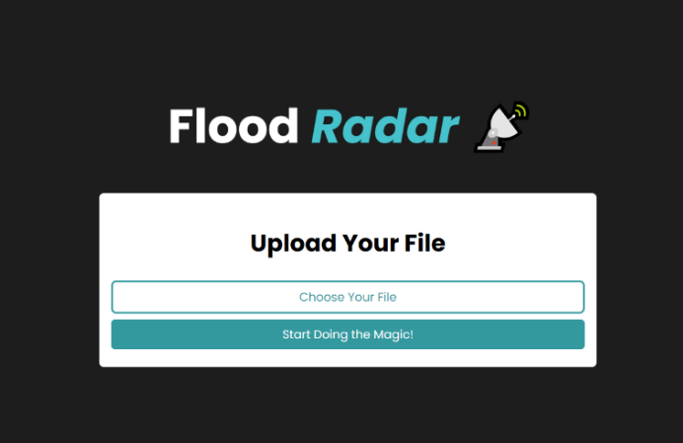
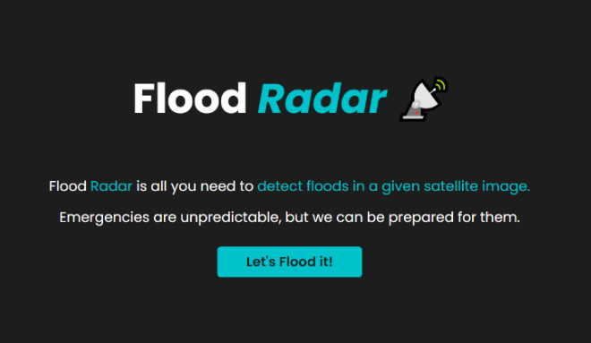
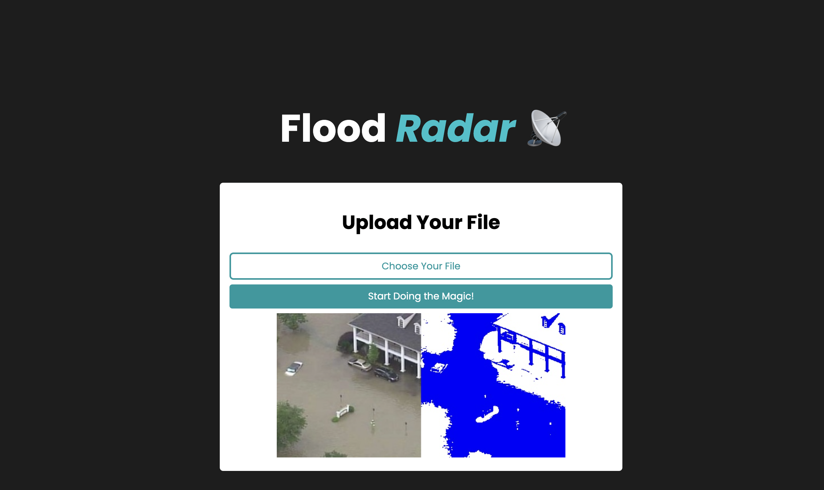
Application

Slide 13
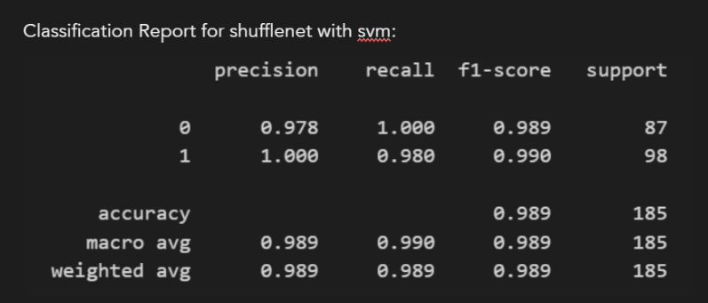
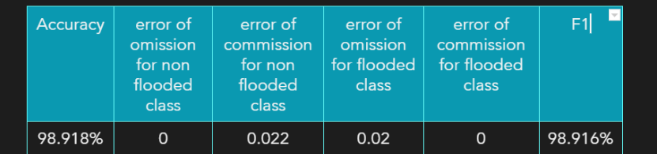
Results & Evaluation
The best results were achieved by extracting embeddings via shufflenet
Classify using SVM
Results:

Slide 14
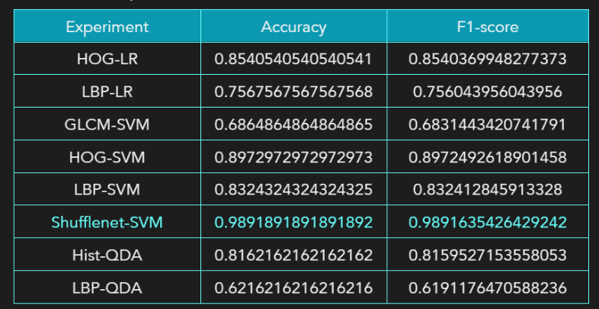
All Experiments Results

Slide 15
Thank You.

